Slide 1
Advanced Mathematics I
Lecturer: Xia Liang-Hui
Department of Mathematics, Jinan University
Office Room: 315, Nanhai Building
Email: xlhui2004@163.com
Office number：020-85228597

Slide 2

Advanced Mathematics I
Answer questions Group:

Slide 3
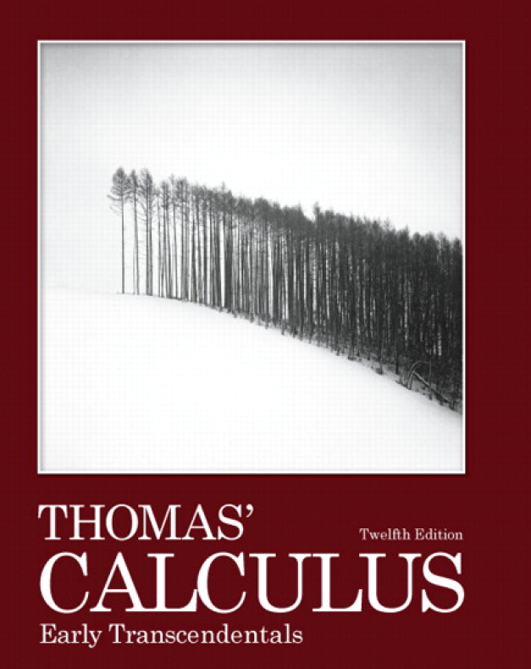
Textbook：Thomas’ Calculus

Slide 4

Reference book：

Slide 5
Requirements:
1、Attend class on time; Don’t leave early
2、Don’t speak or discuss in class, keep silent; Don’t interrupt your classmates
3、Hand in your homework in time

Slide 6
Your Score
（1）Final Exam Score: 70%
（2）Behavior Score: 30%
The second part refers to your attendance, your homework, your class quiz scores…
I will check your attendence at the beginning or at the end of each class.

Slide 7
Introduction to Calculus
（1）Differential Calculus:
Velocity, slope of tangent, rate
of change,…
（2）Integral Calculus:
Area, distance, …

Slide 8
Preliminary
Some special letters:
R: the set of all real numbers
Q: the set of all rational numbers
Z: the set of all integer numbers
N: the set of all nonnegative integer numbers

Slide 9
Section 1.1 Functions and
their graphs

Slide 10

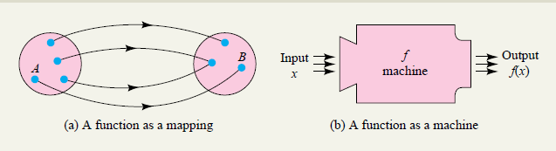
Definition
The value of one variable quantity, say y, depends on the value of another variable quantity, which we might call x. We say that “y is a function of x” and write this symbolically as
y = ƒ(x) (“y equals ƒ of x”).

Slide 11

y = ƒ(x) (“y equals ƒ of x”).
In this notation, the symbol ƒ represents the function, the letter x is the independent variable representing the input value of ƒ, and y is the dependent variable or output value of
ƒ at x.
The set D of all possible input values is called the domain of the function.
The set of all values of ƒ(x) as x varies throughout D is called the range of the function. The range may not include every element in the set Y.

Slide 12
Remark: For two functions, they are equal if and only if they have the same rule and the same domain
Example 1
Whether the following functions are equal?
(1)
(2)

Slide 13

Domain convention: If the domain of a function y=f(x) is not given
explicitly, we assume that the domain of f is the set of all real numbers
such that f(x) is real, we call this domain is the natural domain.
Example 2

Slide 14

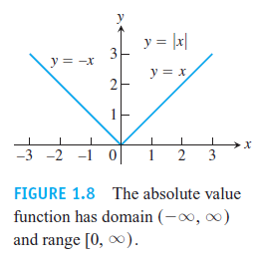
Piecewise-defined finction: On different subset, the expression of
the function are different
Example 3. Absolute value function |x|

Slide 15

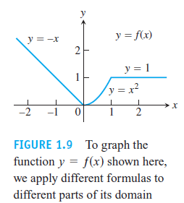
Example 4.

Slide 16
Example 5
Greatest Integer function: The function whose
value at any number x is the greatest integer
less than or equal to x
Important inequality: x−1<[x]≤ x
or [x]≤ x <x+1

Slide 17
Monotonicity of a function
The domain of f (x) is I，
y
If for any two number x₁ and x₂ on I，
when
，
then
then we call f (x) is increasing on I.
o
x₁
x₂
x
If for any two number x₁ and x₂ on I，
y
when
，
then
then we call f (x) is decreasing on I.
o
x₁
x₂
x
Increasing function and decreasing function are called
monotonic functions

Slide 18
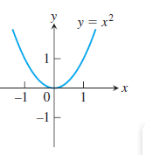
Example 6：
is increasing on
is decreasing on
is not monotone on

Slide 19
3．Odd or even function
Suppose that the domain of f (x) is D which is symmetric about the
origin
If for any
then we call f (x) is an even function
If for any
then we call f (x) is an odd function
Remark
(1) The graph of the even function is symmetric about y-axis, a reflection across the y-axis leaves the graph unchanged.
(2) The graph of the odd function is symmetric about the origin, a
graph is symmetric about the origin if a rotation of 180° about the
origin leaves the graph unchanged.

Slide 20
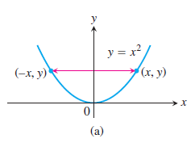
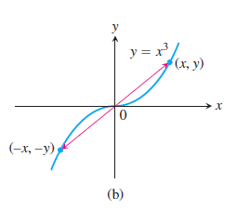

Slide 21
Example 7：
If ，
and when ,
且

Slide 22
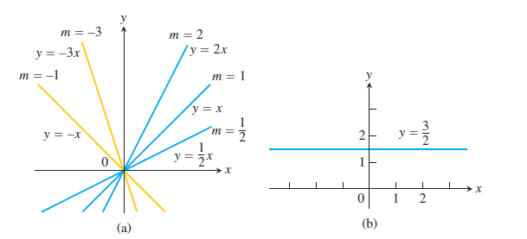
Examples：
Constant function
Dirichlet Function
y
1
o
x
Linear Functions: A function of the form for constants m
and b, is called a linear function.

Slide 23
DEFINITION: Two variables y and x are proportional (to one another) if one is always a constant multiple of the other; that is, y=kx if for some nonzero constant k.
If the variable y is proportional to the reciprocal 1/x then sometimes it is said that y is inversely proportional to x (because 1/x is the multiplicative inverse of x).

Slide 24

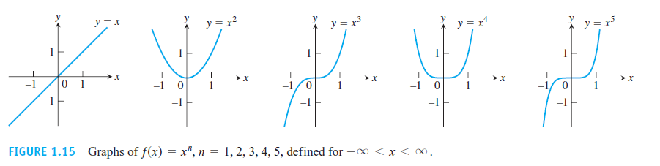
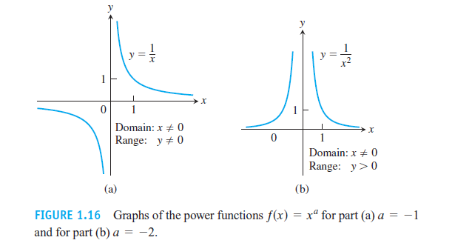

Slide 25
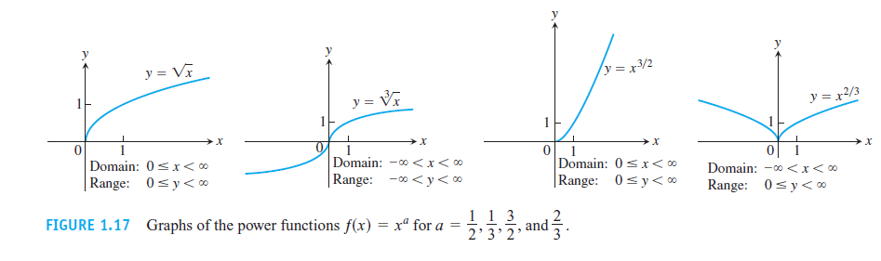
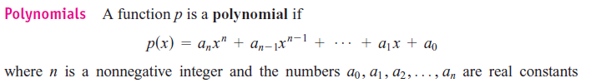
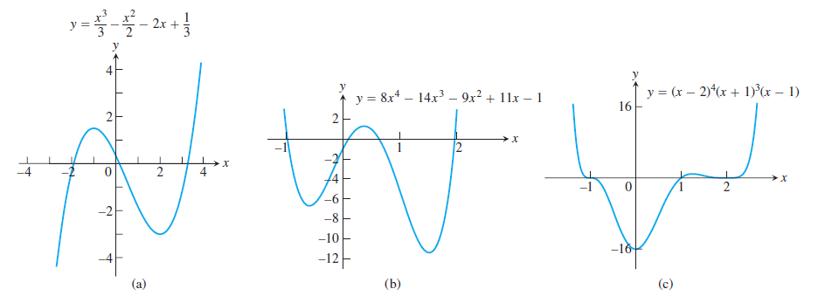

Slide 26
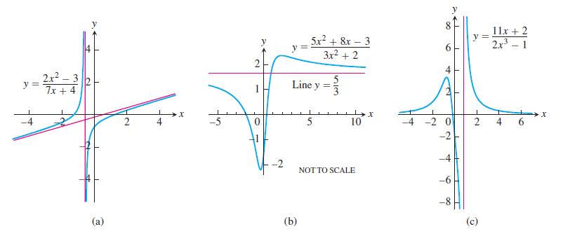
Rational Functions A rational function is a quotient or ratioƒ(x) = p(x)/q(x), where p and q are polynomials. The domain of a rational function is the set of all real x for which
q≠0.

Slide 27
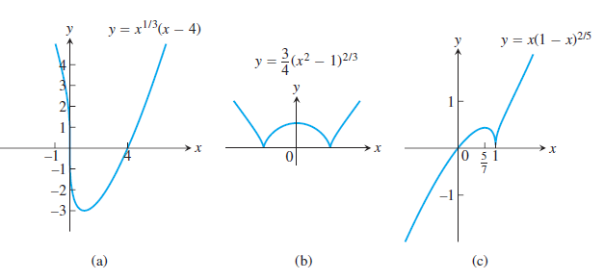
Algebraic Functions Any function constructed from
polynomials using algebraic operations (addition, subtraction, multiplication, division, and taking roots) lies within the class
of algebraic functions. All rational functions are algebraic, but also included are more complicated functions

Slide 28
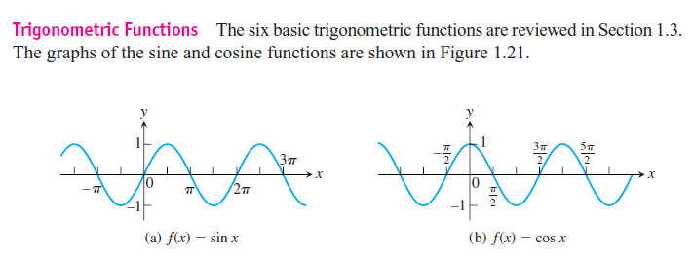

Slide 29
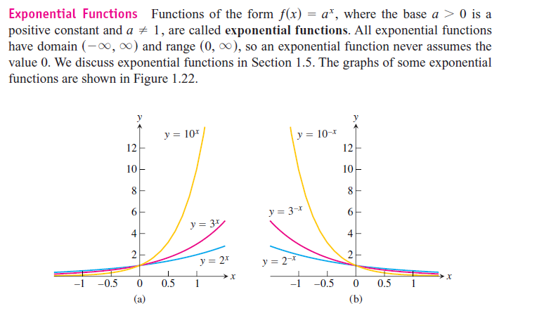

Slide 30
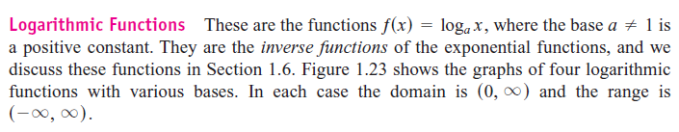
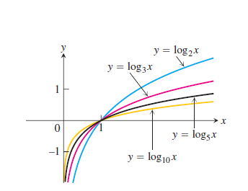

Slide 31


Section 1.2 Combining Functions;
(1) Sums, Differences, Products, and Quotients

Slide 32

(2) Composite functions
Definition:
If the domain of y=f (u) is
the domain of u=g (x) is
and
we call this function is the composite function of u=g(x)and y=f (u),
And we denoted by (“ƒ composed with g”).

Slide 33
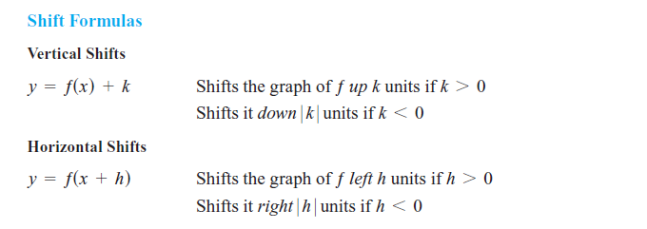
Example: How to obtain the graph of y=|2x−2|−1 from the
graph of y=|x|

Slide 34
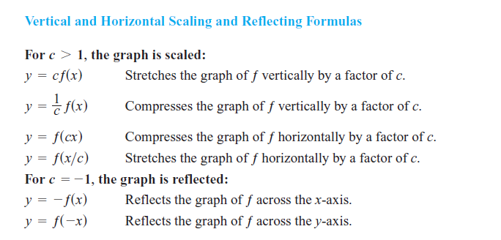
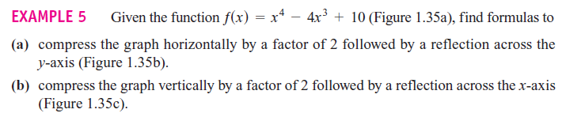

Slide 35
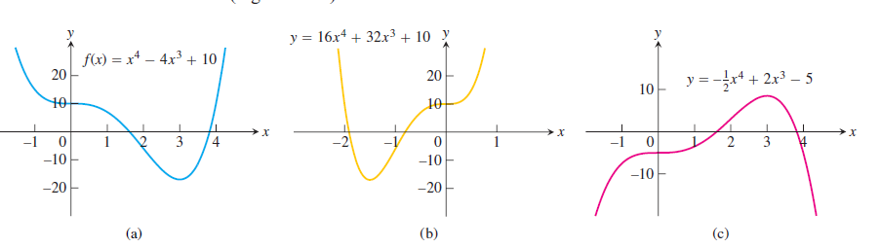

Slide 36
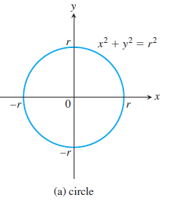

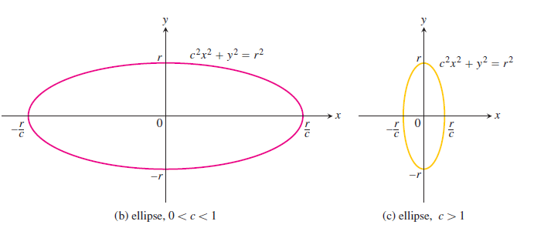
Ellipses

Slide 37
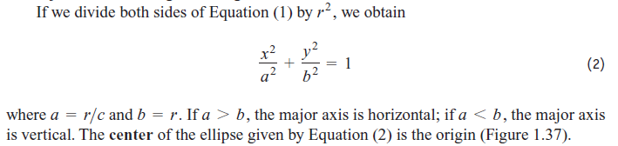
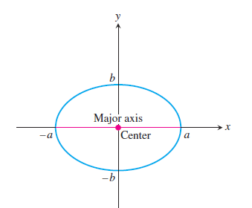
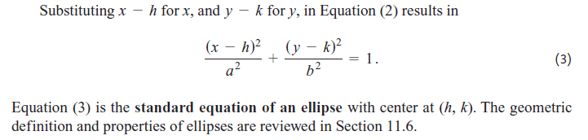

Slide 38
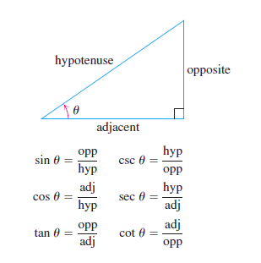
Section 1.3 Trigonometric Functions
The Six Basic Trigonometric Functions

Slide 39
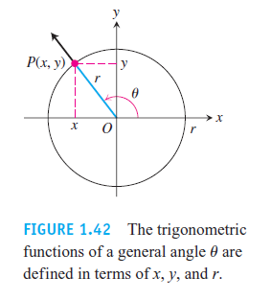
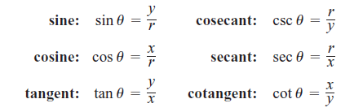
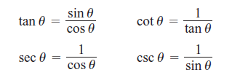

Slide 40
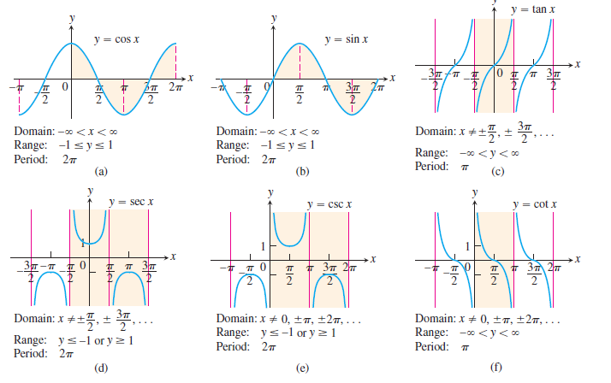

Slide 41


DEFINITION: A function ƒ(x) is periodic if there is a positive number p such that
ƒ(x + p) = ƒ(x) for every value of x.
The smallest such value of p is the period of ƒ.
Pythagorean theorem

Slide 42
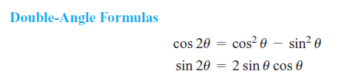
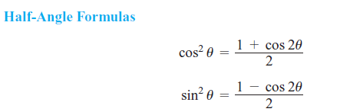
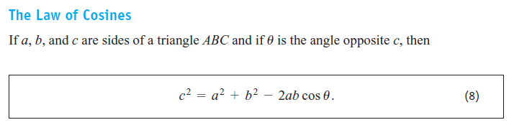

Slide 43
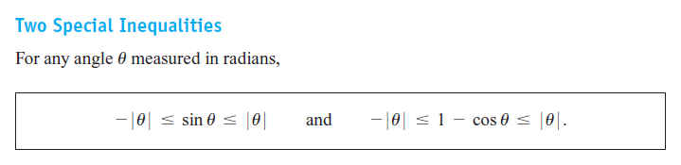
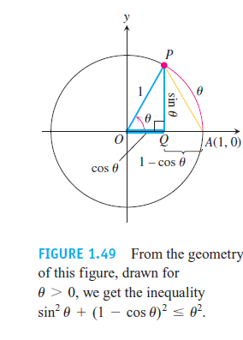

Slide 44


Section 1.6 Inverse functions and inverse
trigonometric Functions

Slide 45


Inverse function
Definition
is one to one，
then for
there exis an unique x corresponding to y,
we denote this
function by , and we call it is the inverse of f
Sometimes，
the inverse of is denoted by

Slide 46
Inverse function
Remarks
(1)
If f is increasing or decreasing on D, then
exists
and
is also increasing or decreasing on f (D)
(2)
The graphs of y=f (x) and its inverse
are symmetric about the line y=x.

Slide 47
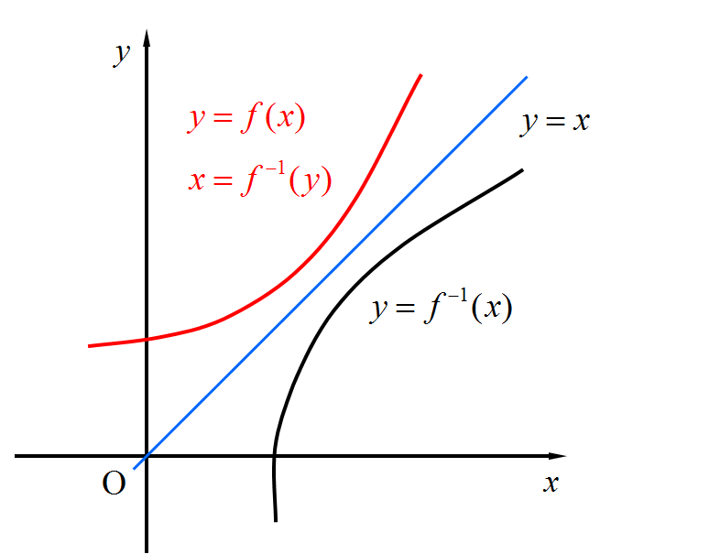

Slide 48
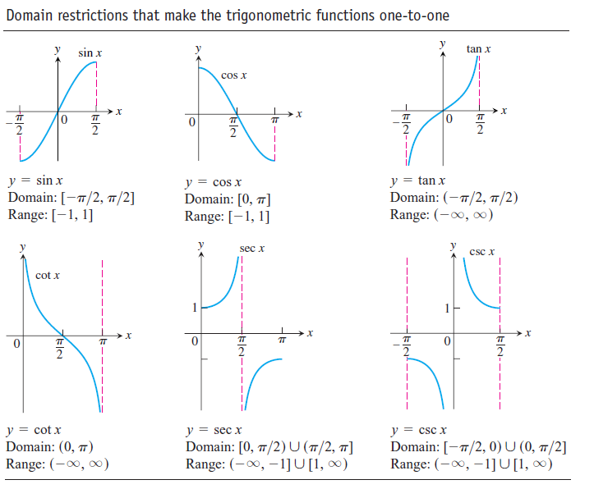

Slide 49
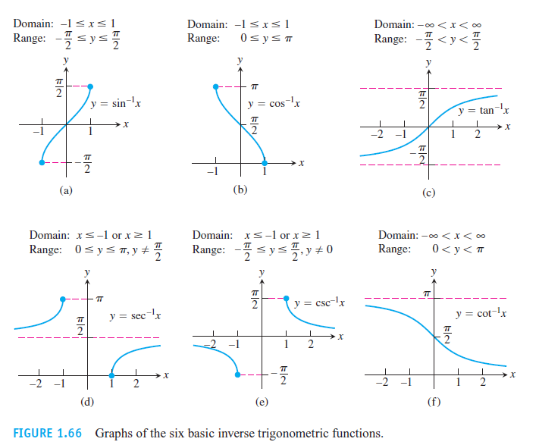

Slide 50
Elementary functions
Basic elementary functions
Constant functions、
Power functions、
Exponential functions、
Logarithmic functions、
Trigonometric functions、
Inverse trigonometric functions
Elementary functions
If the function is obtained from six types of basic elementary functions by finite four algebraic operations or composite operations , then the function is an elementary function.

Slide 51
1. Constant functions y = C
( C is a constant )
2. Power functions y = x ^{α}
( α ∈ R is a constant )
3. Exponential functions y = a ^{x}
( a > 0, a ≠ 1 )

Slide 52
4. Logarithmic functions y = log_{a} x
( a > 0, a ≠ 1 )
5. Trigonometric functions
y = sin x y = cos x y = tan x
y = cot x y = sec x y = csc x
6. Inverse trigonometric functions
y = arcsin x y = arccos y = arctan x
y = arccot x y = arcsec x y = arccsc x

Slide 53
The Graphs of Basic Elementary Functions
1. Constant functions
2. Power functions
y
y
x
o
x
o
3. Exponential Functions
4. Logarithmic functions
y
y
x
x
o
o

Slide 54
5. Trigonometric Functions
y
y
x
x

Slide 55
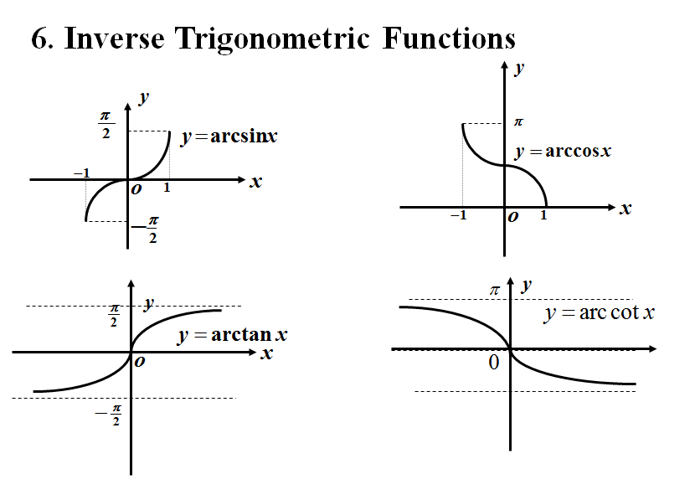

Slide 56
Non-elementary functions
Piecewise-defined function
Signal function
Integer function
Remark:
Not every piecewise-defined finction is non-elementary！
Example：
therefore, it is
elementary.
can be rewritten

